Slide 1

Project Presentation
on
ARTISAN‘S CORNER
Presented By:
AYUSHI KHANDELWAL
(Reg. No. 2024PUFCEBCAX16905)
ADITI JAIN (Reg. No. 2024PUFCEBCAX17806)
DIVYANSHI JAIN(Reg. No. 2024PUFCEBCAX17568)
ADITYA SINGH JADOUN
(Reg. No. 2024PUFCEBCAX16995)
ASHWANI KUMAR (Reg. No. 2024PUFCEBCAX18727)
Department of First Year
Poornima University, Jaipur
Under the Supervision of
Ms. Tanushree Bharti
Assistant Professor,
Faculty of Computer Science and Engineering,
Poornima University, Jaipur
Submitted To:
Department of First Year
Poornima University, Jaipur

Slide 2
Contents
Introduction
What’s our Project about?
Aim of Project
Technical Details
Working of Project
Images and Videos of Project
Conclusion and Future work
References

Slide 3
INTRODUCTION
Art and Craft Website - A Hub for Creativity:
Welcome to our website dedicated to the world of art and craft, where you can explore a vibrant community of artists and creators, discover unique handmade goods, and learn new skills through workshops and events.

Slide 4
WHAT’S OUR PROJECT ABOUT
Empowering Artisans & Creators:
This project aims to create a platform for artisans and creators to showcase their work, sell products, and connect with a broader audience. The platform provides centralized space for artists to exhibit their talents engage with potential customers, and build a thriving online community.

Slide 5
AIM OF THE PROJECT
Showcase Work:
This website can be used to display artwork and crafts, share the artist's story, and create an engaging online presence.
Sell Products:
The platform allows artists to sell their work directly to customers, streamlining the purchasing, stocking, and delivery processes.
Connect with Others:
The platform enables collaboration among artists, allowing them to share ideas, resources, and opportunities.
Build a Community:
This website fosters a community around each artist's work, engaging visitors through a blog or contact form, and encouraging interaction.

Slide 6
TECHNICAL DETAILS
HTML and CSS:
HTML acts as the foundation, defining the structure and content of your website. CSS, on the other hand, is responsible for the visual presentation, styling the layout and appearance of the website.
Domain Name and Hosting:
A domain name is your website's unique address on the internet, while hosting provides the space on a server where your website files are stored, making it accessible to visitors.
Security:
Implementing security measures is essential to protect user data, especially if you're collecting information or facilitating online transactions.
JavaScript:
JavaScript adds interactivity and dynamic features to your website, creating engaging user experiences, from animated elements to interactive forms.

Slide 7
WORKING OF PROJECT
Website Overview.
Features.
E – Commerce Platforms and Database Management.
Navigation and Server Configuration.
Navigation and Design.
Target Audience.
Benefits.
Revenue Streams.

Slide 8
Website Overview:
An engaging online platform showcasing artistic creations, crafting tutorials and inspiring creativity. This Art and craft website fosters creativity, learning and community engagement.

Slide 9
Features:
1. Gallery Showcase: Artwork, crafts and designs. 2. Tutorial Section: Step-by-step guides for various art and craft techniques. 3. Artist Spotlight: Featured artist profiles and interviews. 4. Community Forum: Discussion board for sharing ideas and feedback. 5. Shopping Area: Art supplies, crafting materials and handmade products. 6. Blog: News, trends and inspiring stories. 7. Workshop and Class Listings: Online and offline art and craft courses. 8. Resource Library: eBooks, videos and downloadable guides.

Slide 10
E-commerce Platforms and Database Management
E-commerce Platforms: A robust e-commerce platform is crucial for managing product listings, processing orders, and handling payments. Choosing the right platform depends on your website's scale and specific needs.
Database Management: A reliable database is essential for storing customer data, product information, and website settings. Effective database management ensures data integrity, security, and efficient data retrieval.

Slide 11
Navigation and Server Configuration
1.Intuitive Navigation: A well-structured navigation system is crucial for user experience. It should allow visitors to easily browse categories, find specific products, and navigate seamlessly through the website.
2.Server Configuration: Optimizing server configuration is key for website performance and security. This includes choosing the right server type, configuring security measures, and ensuring adequate storage space.
3.Website Security: Protecting customer data and preventing security breaches is paramount. Implementing SSL certificates, secure logins, and regular security audits are essential.

Slide 12
Navigation and Design:
1. User-Friendly Interface:
Easy navigation and search functionality.
2. Responsive Design:
Compatible with desktop, tablet and mobile devices.
3. Visual Appeal:
High-quality images, vibrant colors and clean layout.
4. Clear Categories:
Organization by art/craft type, medium and difficulty level.

Slide 13
Target Audience:
1. Artists: • Professionals, hobbyists and emerging talent. 2. Crafters: • Knitters, sewers, painters and makers. 3. Students: • Art and design students seeking inspiration and guidance. 4. Educators: • Teachers seeking resources and lesson plans. 5. Art Enthusiasts: • Those passionate about creative expression.

Slide 14
Benefits:
1. Inspiration: Spark creativity and explore new techniques.
2. Community: Connect with fellow artists and crafters.
3. Learning: Access tutorials, workshops and resources.
4. Shopping: Convenient access to art supplies and handmade products.
5. Networking: Opportunities for collaboration and feedback.

Slide 15
Revenue Streams:
1. Sponsored Content: Partnered tutorials and workshops. 2. Product Sales: Handmade crafts, art supplies and digital resources. 3. Membership/Subscription Model: Exclusive content and discounts.

Slide 16

Images and Videos of Project
LOGO:

Slide 17
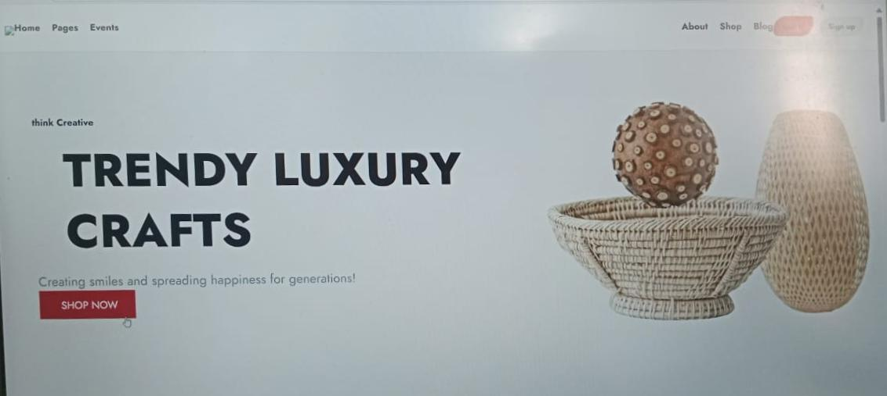
Images and Videos of Project
HOME PAGE:

Slide 18
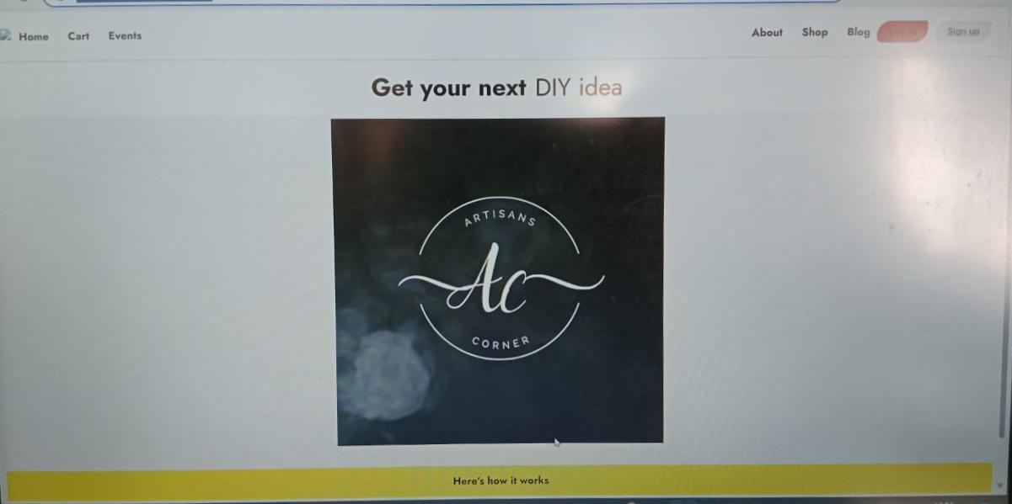
Images and Videos of Project
HOME PAGE:

Slide 19
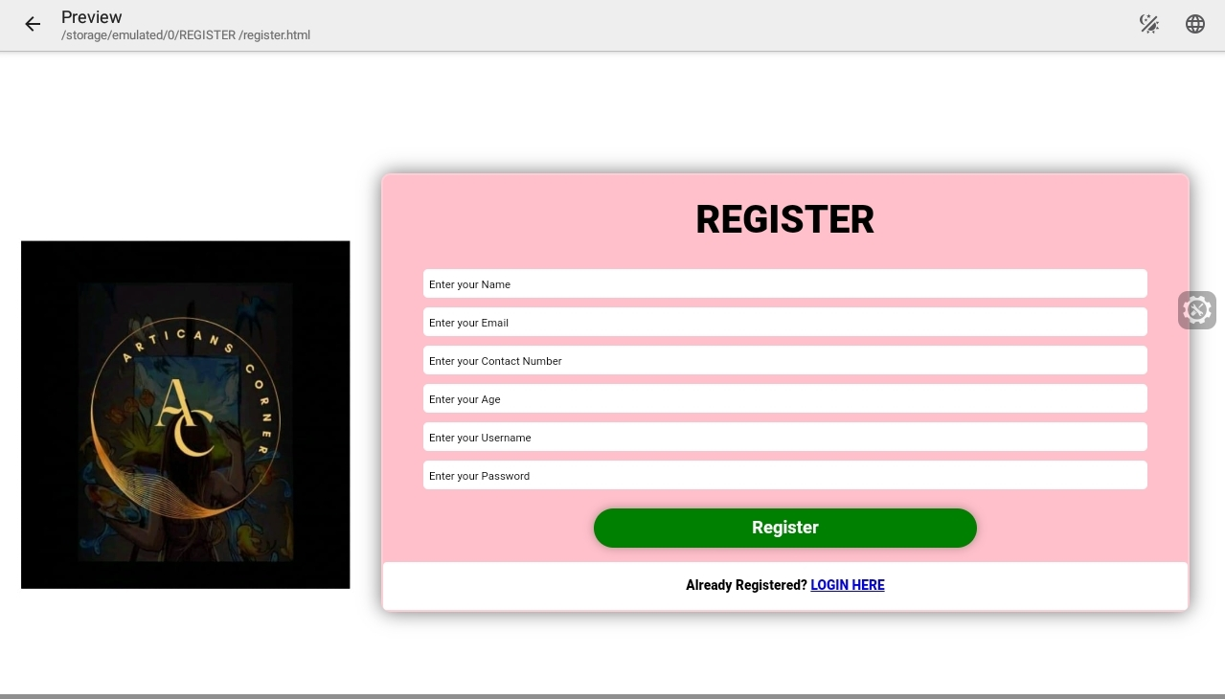
Images and Videos of Project
REGISTRATION PAGE:

Slide 20
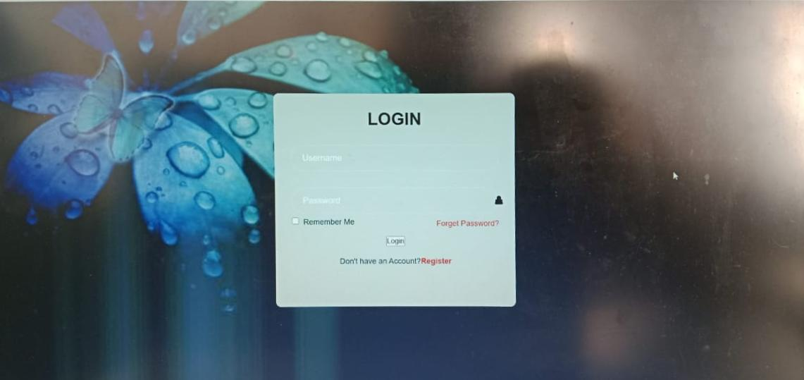
Images and Videos of Project
LOGIN PAGE:

Slide 21
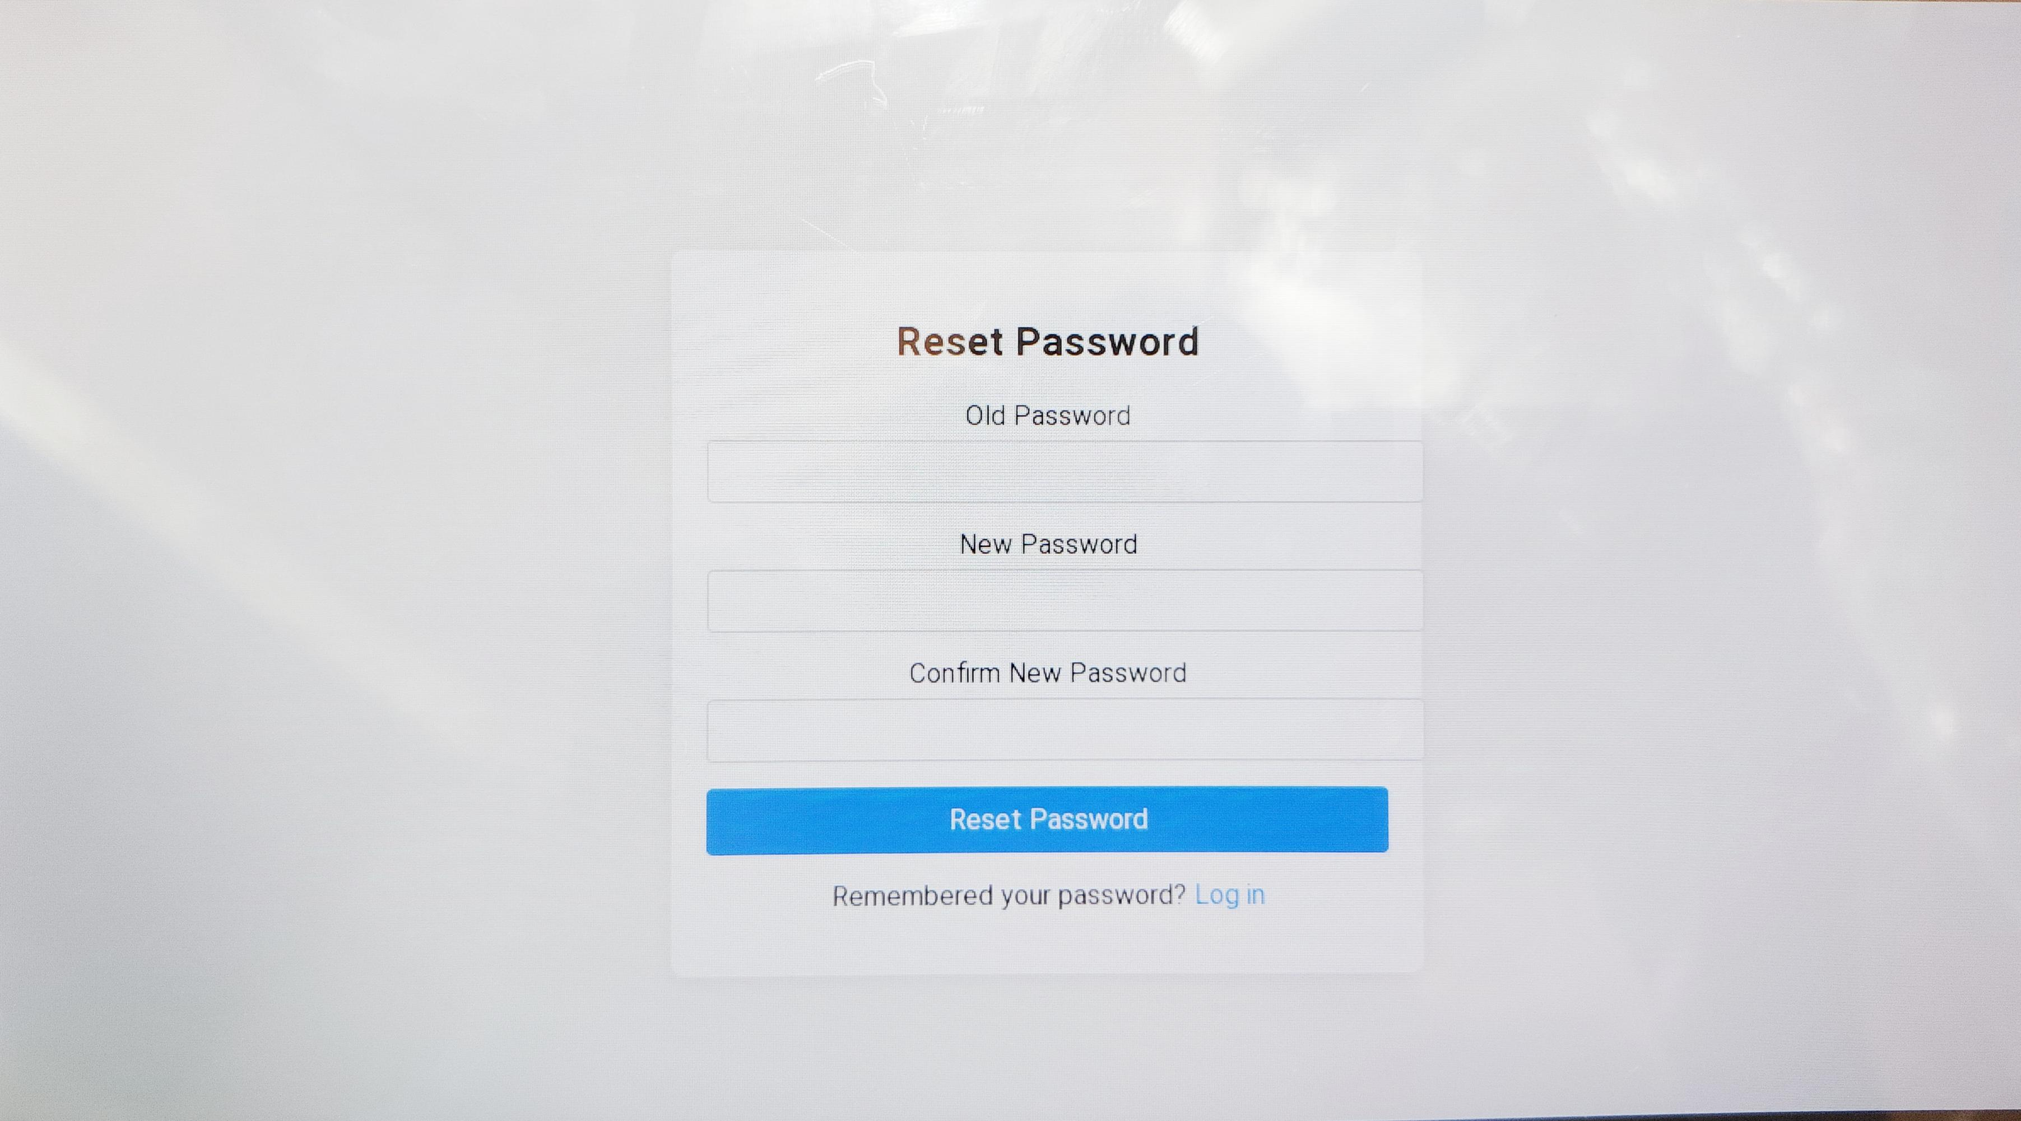
Images and Videos of Project
FORGOT PASSWORD PAGE:

Slide 22
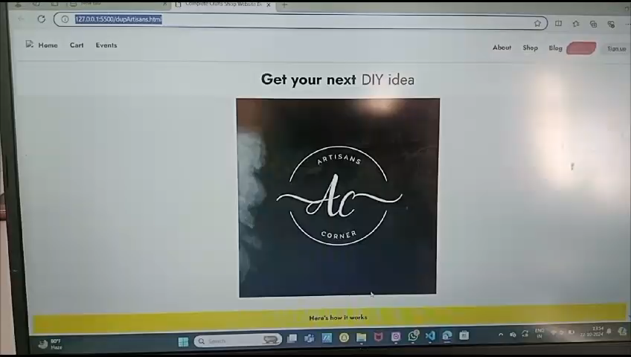
Images and Videos of Project

Slide 23
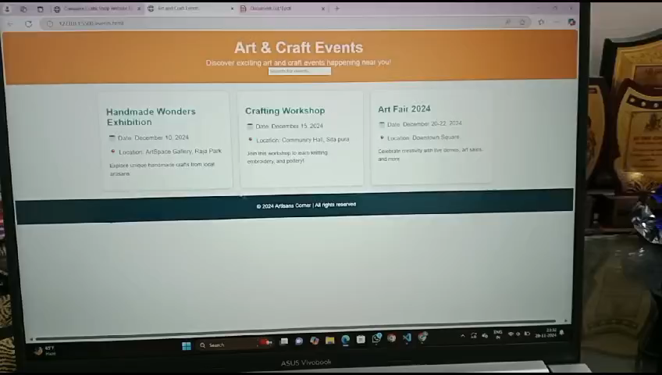
Images and Videos of Project

Slide 24
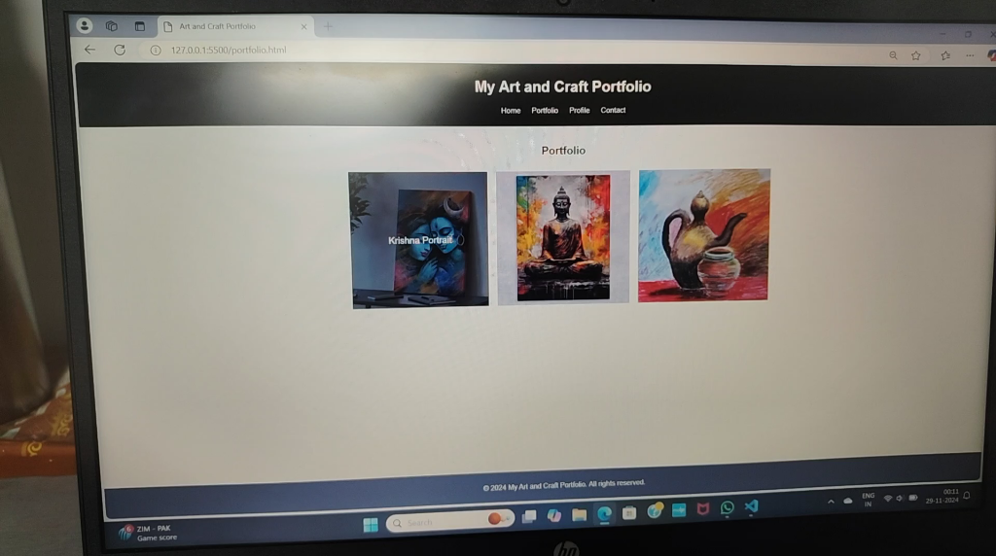
Images and Videos of Project

Slide 25


